Slide 1

ESTIMATION FOR SOFTWARE PROJECTS
Sample problems and solutions
Unit II

Slide 2
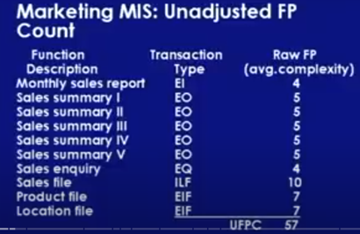
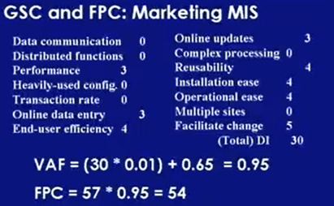
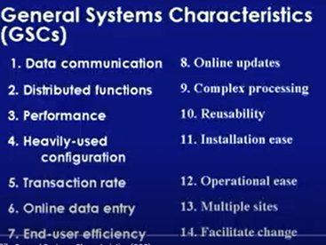
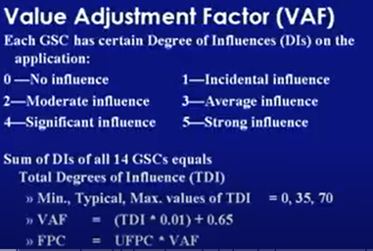
Example1: MIS sw consist of

Slide 3
FAQs
1.It is given that the complexity weighting factors for I, O, E, F, and N are 4, 5, 4, 10, and 7, respectively. It is also given that, out of fourteen value adjustment factors that influence the development effort, four factors are not applicable, each of the other four factors has value 3, and each of the remaining factors has value 4. The computed value of the function point metric is _____. [GATE CS 2015]
(A) 612.06 (B) 404.66 (C) 305.09 (D) 806.9
Solution: Correct Answer is (A).
For example, if the software project has 30 external inputs, 60 external outputs, 23 external inquiries, 8 internal logical files, and 7 external interface files, and the value adjustment factors are 3, 3, 3, 3, 0, 0, 0, 0, 4, 4, 4, 4, 4, and 4, then the function point metric can be calculated as follows:
UFP = (30 * 4) + (60 * 5) + (23 * 4) + (8 * 10) + (7 * 7) = 606
VAF = 0.65 + (0.01 * (3 + 3 + 3 + 3 + 0 + 0 + 0 + 0 + 4 + 4 + 4 + 4 + 4 + 4)) = 1.01
FP = UFP * VAF = 606 * 1.01 = 612.06

Slide 4
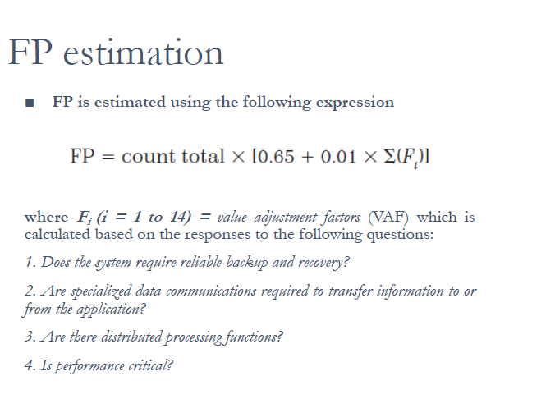

Slide 5
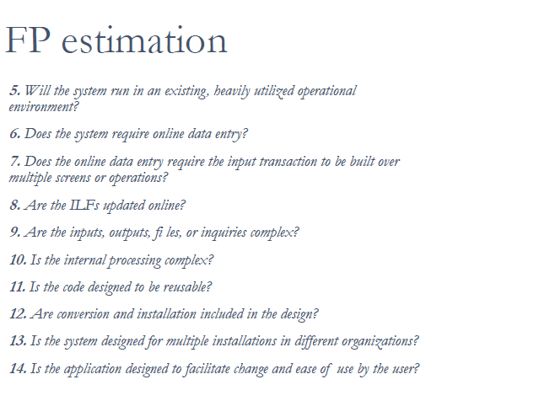
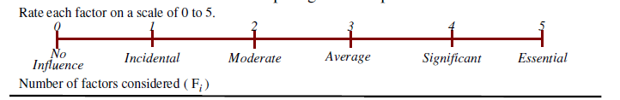

Slide 6
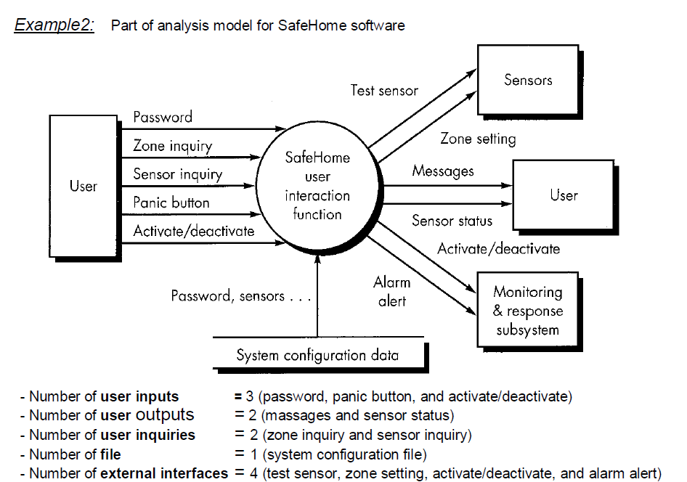
FP Technique (Function Point Technique)

Slide 7
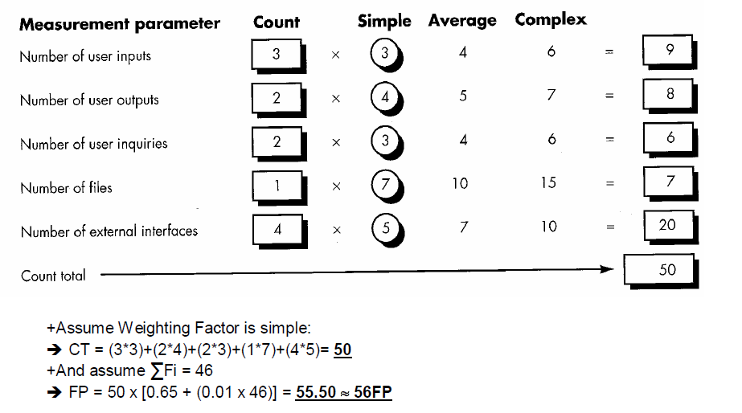

Slide 8
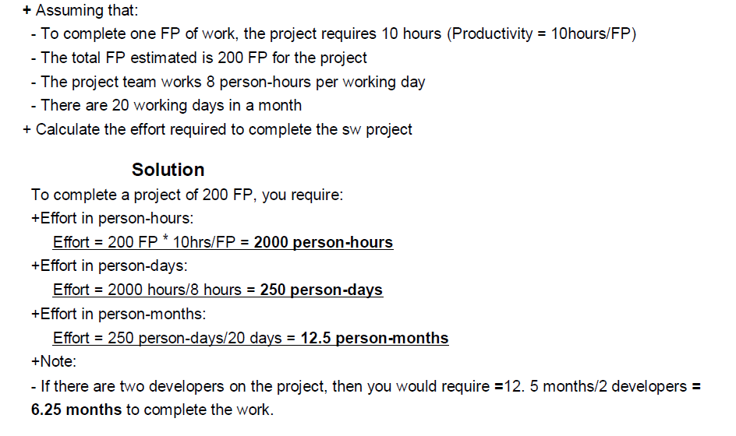

Slide 9
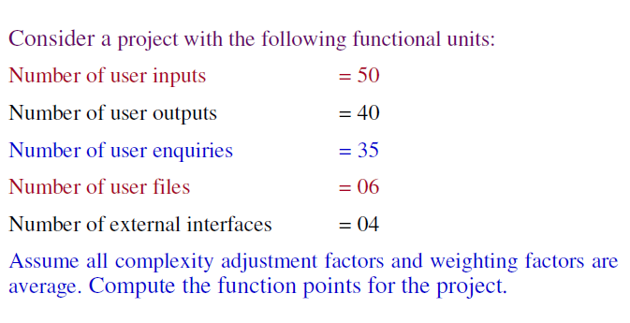
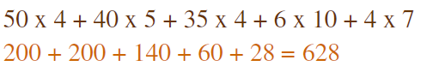

Example 3
Consider Adjustment factor = 42
Count =
FP = 628 x(0.65+0.01(42))

Slide 10
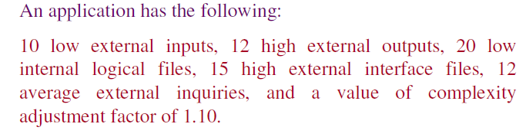
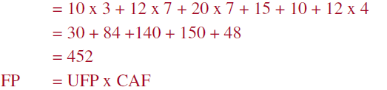
Example 4

Slide 11
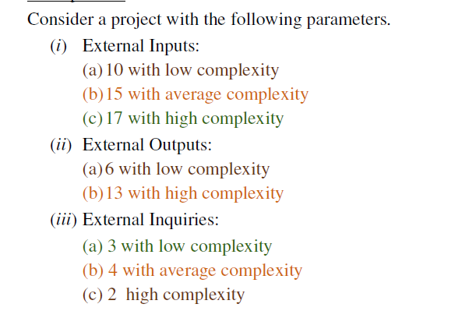

Slide 12
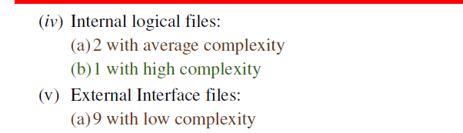

Slide 13
Estimation with Usecases
Use cases provide a software team with insight into software scope and requirements.
Use cases are described using many different formats and styles - there is no standard form.
Use cases represent an external view (the user’s view) of the software and can therefore be written at many different levels of abstraction.
Use cases do not address the complexity of the functions and features that are described.
Use cases can describe complex behavior (e.g., interactions) that involve many functions and features.
One person’s “use case” may require months of effort while another person’s use case may be implemented in a day or two.

Slide 14
Smith argues that any level of this structural hierarchy can be described by no more than 10 use cases.
Use cases that describe a large system are written at a much higher level of abstraction than
use cases that are written to describe a single subsystem
Before use cases can be used for estimation,
level within the structural hierarchy is established
the average length (in pages) of each use case is determined
type of software (e.g., real-time, business, engineering/scientific, WebApp, embedded) is defined
Rough architecture for the system is considered.

Slide 15
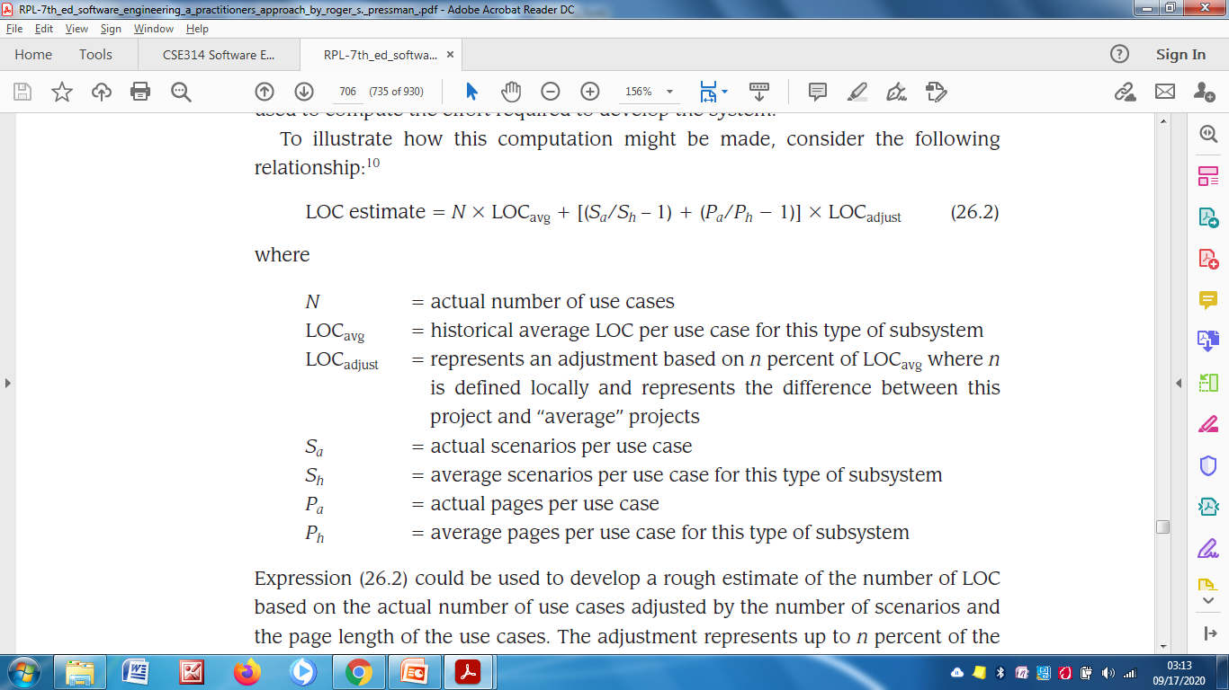

Slide 16
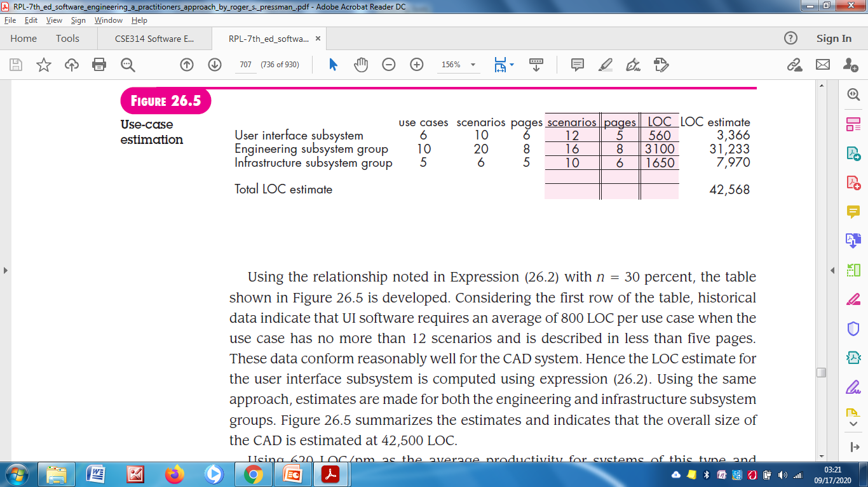
Use-Case Based Estimation
CAD software is composed of three subsystem groups
user interface subsystem
engineering subsystem group
infrastructure subsystem group

Slide 17
Reconciling Estimates
Single estimate of project.
Project duration (or) Cost.
Total estimated effort for the CAD software ranges from a low of 46 person-months to a high of 68 person-months.
Average estimate is 56 person-months.

Slide 18
TOPIC – 4 Empirical Estimation Techniques

Slide 19
Empirical Estimation Models
An estimation model for computer software uses empirically derived formulas to predict effort as a function of LOC or FP.
The empirical data that support most estimation models are derived from a limited sample of projects.
The model should be tested by applying data collected from completed projects.
Plugging the data into the model.
Then comparing actual to predicted results.
If agreement is poor, the model must be tuned and retested before it can be used.

Slide 20
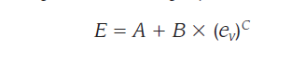
The Structure of Estimation Models
A typical estimation model is derived using regression analysis on data collected from past software projects.
Overall structure of such models takes the form.
where,
A,B and C are empirically derived constants.
E is effort in person-months
e_{v} is the estimation variable either LOC (or) FP

Slide 21
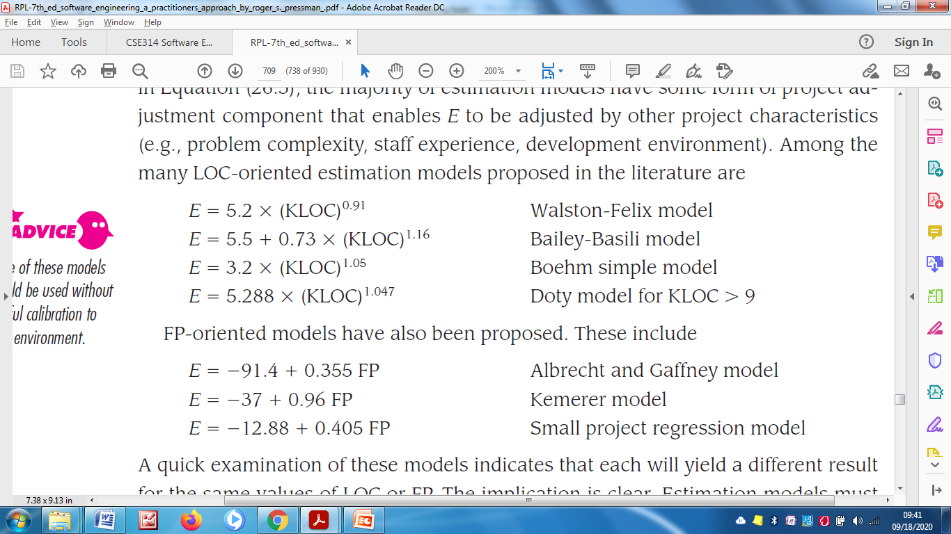
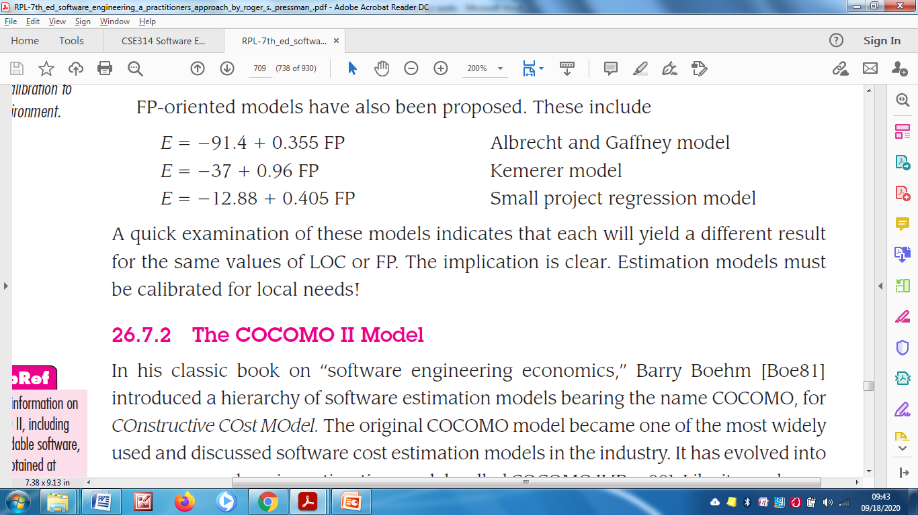
LOC-Oriented estimation models in the literature as follows :
FP-Oriented estimation models in the literature as follows :

Slide 22
COCOMO-II Model
COnstructive COst MOdel (COCOMO) II is actually a hierarchy of estimation models that address the following areas.
Application Composition Model.
Used during the early stages of software engineering
When prototyping of user interfaces
Consideration of Software and System Interaction
Assessment of Performance.
Early Design Stage Model.
Used once requirements have been stabilized and
Basic software architecture has been established.
Post-Architecture-Stage Model.
Used during the construction of the software.

Slide 23
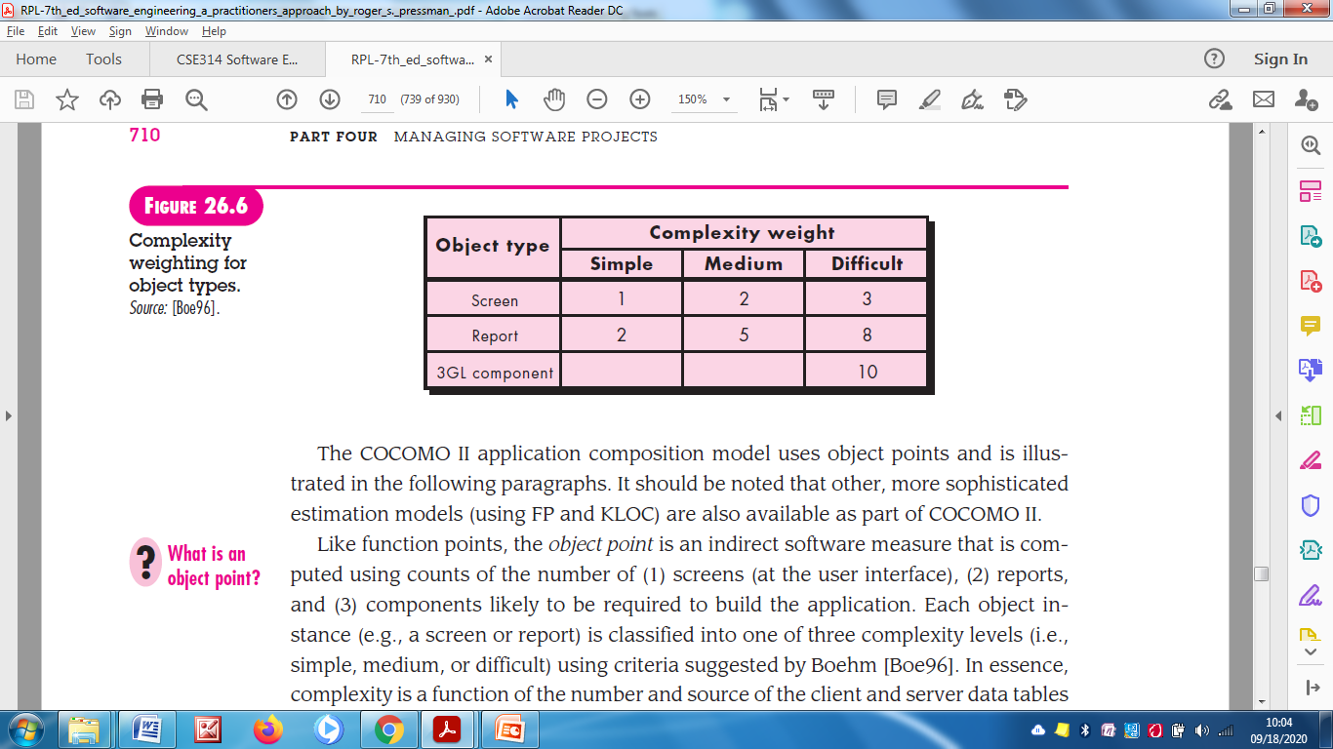
Like all estimation models for software, COCOMO II model require sizing information.
Three different sizing options are available.
Object Point
Function Point and
Lines of Source Code
Object Point
Indirect software measure that is computed using counts of the number of,
Screens, Reports and Components likely to be required to build the application

Slide 24
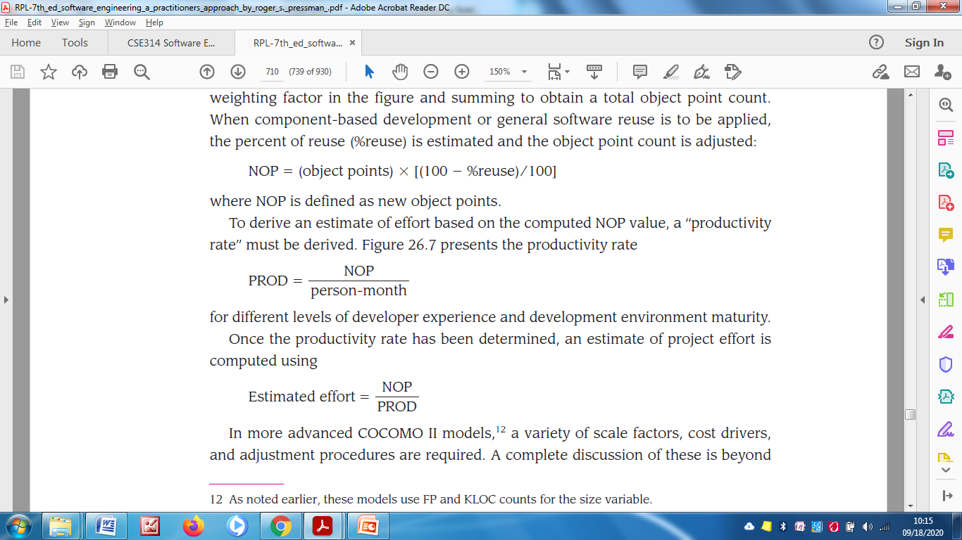
Object point count is then determined by multiplying the original number of object instances by the weighting factor.

Slide 25
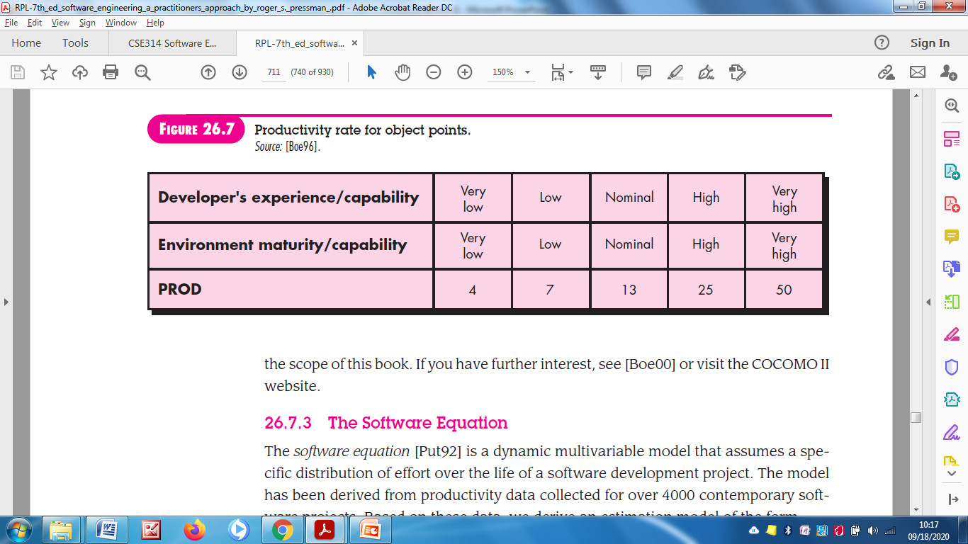

Slide 26
Software Equation
Software equation is a dynamic multivariable model that assumes a specific distribution of effort over the life of Software Development Project.
The model has been derived from productivity data collected for over 4000 contemporary software projects.

Slide 27
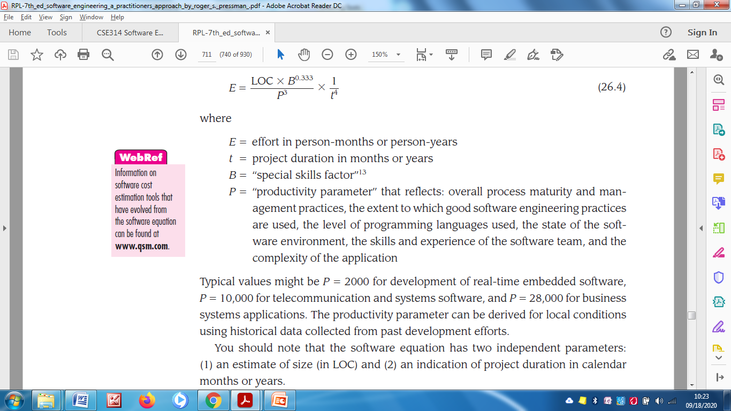

Slide 28
TOPIC – 5 Estimation for Object Oriented Projects

Slide 29
Estimation for Object Oriented Projects
To supplement conventional software cost estimation methods with a technique that has been designed explicitly for OO software.
Develop estimates using effort decomposition, FP analysis, and any other method that is applicable for conventional applications.
Using the requirements model, develop use cases and determine a count.
From the requirements model, determine the number of key classes.
Categorize the type of interface for the application and develop a multiplier for support classes.

Slide 30
Multiply the total number of classes (key + support) by the average number of work units per class. Lorenz and Kidd suggest 15 to 20 person-days per class.
Cross-check the class-based estimate by multiplying the average number of work units per use case.

Slide 31
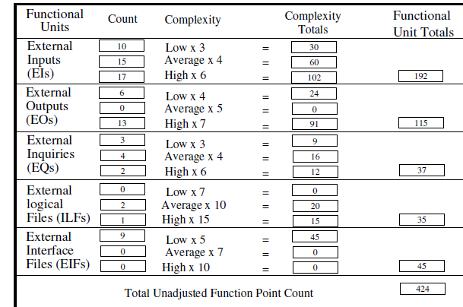
Solution

Slide 32
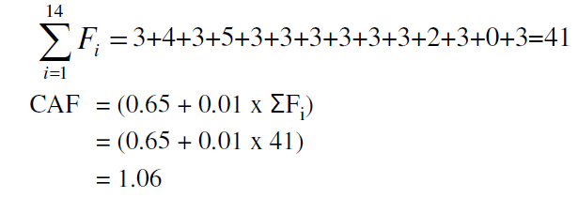
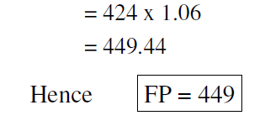
Adjustment factor
FP

Slide 33
Problem-Based Estimation
Start with a bounded statement of scope
Decompose the software into problem functions that can
each be estimated individually
Compute an LOC or FP value for each function
Derive cost or effort estimates by applying the LOC or FP values to your baseline productivity metrics (e.g., LOC/person-month or FP/person-month)
Combine function estimates to produce an overall estimate for the entire project
(More on next slide)
25

Slide 34
Problem-Based Estimation (continued)
In general, the LOC/pm and FP/pm metrics should be computed by project domain
Important factors are team size, application area, and
complexity
LOC and FP estimation differ in the level of detail required for decomposition with each value
For LOC, decomposition of functions is essential and should go into considerable detail (the more detail, the more accurate the estimate)
For FP, decomposition occurs for the five information domain characteristics and the 14 adjustment factors
External inputs, external outputs, external inquiries, internal logical files, external interface files
26
pm = person month

Slide 35

Problem-Based Estimation (continued)
For both approaches, the planner uses lessons learned to estimate an optimistic, most likely, and pessimistic size value for each function or count (for each information domain value)
Then the expected size value S is computed as follows:
S = (S_{opt} + 4S_{m} + S_{pess})/6
Historical LOC or FP data is then compared to S in order to cross-check it
27

Slide 36
Example
The best case to complete this task is 120 man-hours (around 15 days). In this case, you have a talented team, they can finish the task in smallest time.
The most likely case to complete this task is 170 man-hours (around 21 days). This is a normal case, you have enough resource and ability to complete the task
The worst case to complete this task is 200 man-hours (around 25 days). You need to perform much more work because your team members are not experienced.

Slide 37
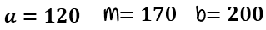
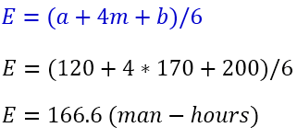
Example…
Now, assign the value to each parameter as below
The effort to complete the task can be calculated using double-triangular distribution formula as follows-

Slide 38
Example 2
The organizational average productivity for systems of this type is 620 LOC/pm. Based on a burdened labor rate of $8000 per month, the cost per line of code is approximately $13. Based on the LOC estimate and the historical productivity data, Calculate the total estimated project cost.
Ans:
Total Effort = Total LOC/Productivity = 33200/620=53.54 ≈ 54 person-months => 6 developers ➔Effort = Total Effort/6 = 54/6 = 9 months => Total Cost = Total Effort * Labor Rate = 54 * 800 ≈ $43,200

Slide 39
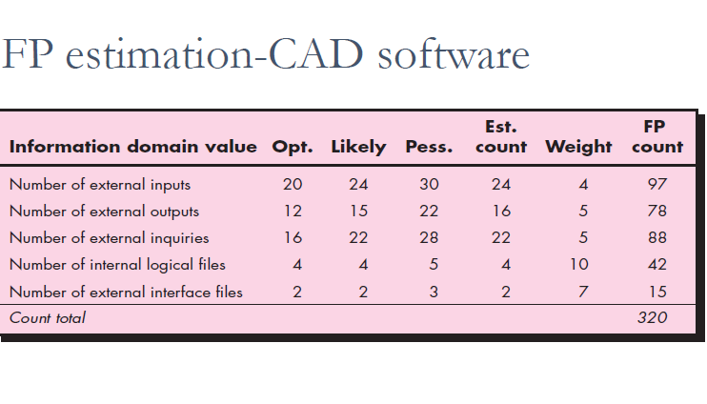

Slide 40
Process-Based Estimation
Identify the set of functions that the software needs to
perform as obtained from the project scope
Identify the series of framework activities that need to be performed for each function
Estimate the effort (in person months) that will be required to accomplish each software process activity for each function
(More on next slide)
28

Slide 41
Process-Based Estimation (continued)
Apply average labor rates (i.e., cost/unit effort) to the effort estimated for each process activity
Compute the total cost and effort for each function and each framework activity
Compare the resulting values to those obtained by way of the LOC and FP estimates
If both sets of estimates agree, then your numbers are
highly reliable
Otherwise, conduct further investigation and analysis concerning the function and activity breakdown
29

Slide 42
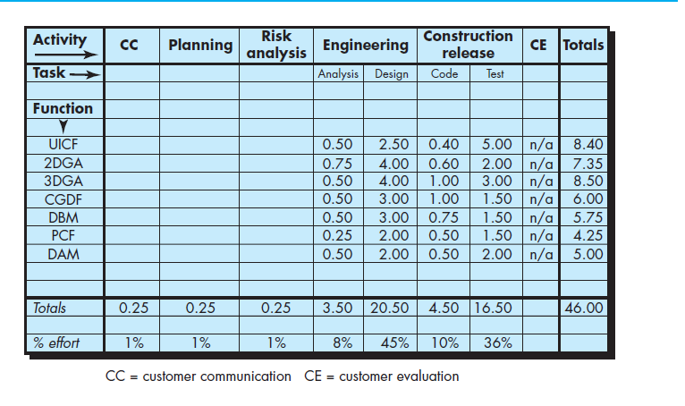
Example

Slide 43
Example…
It should be noted that 53 percent of all effort is expended on front-end engineering tasks (requirements analysis and design).
Based on an average burdened labor rate of $8,000 per month, the total estimated project cost is $368,000 and the estimated effort is 46 person-months..

Slide 44
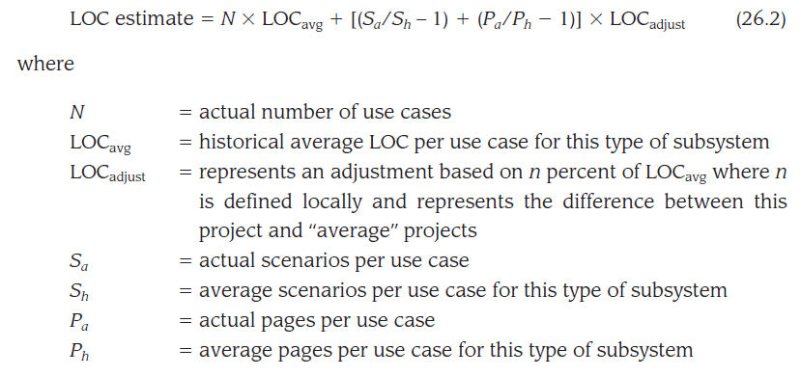
Estimation with the Use Cases
Each person will have each use cases
The estimation is done through the below formula

Slide 45
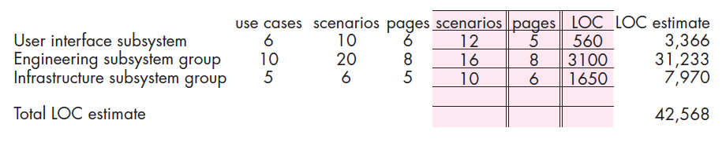
Example
n = 30 % , LOC average = 560
N= number of use cases for 1st sub system is 6
LOC avg = 560 , sa=10, sh=12, pa=6, ph =5
loc adjust = 30% of 560
apply all these in the formula stated in the slide 26
LOC estimate = 6*(560)+[(10/12 -1)+(6/5-1]*(30% of 560)
= 6*560 +(-0.16+0.2)*240
= 3360+0.04*240
=3367.2 =approximately = to 3366.
Using 620 LOC/pm as the average productivity for systems of this type and a burdened labor rate of $8000 per month, the cost per line of code is approximately $13. Based on the use-case estimate and the historical productivity data, the total estimated project cost is $552,000 and the estimated effort is 68 person-months.

Slide 46
Estimation with use cases…
Use cases are described using many different formats and styles and represent an external view (the user’s view) of the software.
Therefore, they can be written at many different levels of abstraction. Use cases do not address the complexity of the functions and features that are described,
they can describe complex behavior (e.g., interactions) that involve many functions and features.

Slide 47
Steps to compute use case estimation
To compute use case points (UCPs) –similar to function point
Computation of use case points must take the following characteristics
The number and complexity of the use cases in the system.
The number and complexity of the actors on the system.
Various nonfunctional requirements (such as portability, performance, maintainability) that are not written as use cases.
The environment in which the project will be developed (e.g., the programming language, the software team’s motivation).

Slide 48
Complexity factors for each usecase
Simple | Simple UI | Single DB | <=3 transactions | <5 classes | 5
Average | More complex UI | 2 or 3 DB | 4 to 7 transactions | 5 to 10 classes | 10
Complex | Complex UI | Multiple DB | >8 transactions | >11 classes | 15
total unadjusted use case weight (UUCW) is the sum
of all weighted counts

Slide 49
each actor is assessed as..
Simple actor | another system, a machine or device, communicate through an API | 1
Average actors | automatons that communicate through a protocol or a data store | 2
complex actors | humans who communicate through a GUI or other human interface | 3
total unadjusted actor weight (UAW) is
the sum of all weighted counts.

Slide 50

TCF and ECF..
These unadjusted values are modified by considering technical complexity factors (TCFs) and environment complexity factors (ECFs). Thirteen factors contribute to an assessment of the final TCF, and eight factors contribute to the computation of the final ECF
Final UCP value is computed in the following manner:

Slide 51
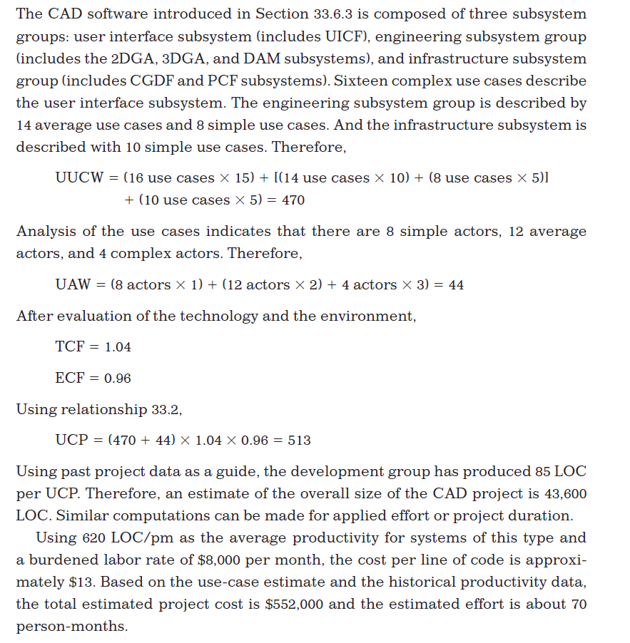

Slide 52
Reconciling Estimates
The results gathered from the various estimation techniques must be reconciled to produce a single estimate of effort, project duration, and cost
If widely divergent estimates occur, investigate the following causes
The scope of the project is not adequately understood or
has been misinterpreted by the planner
Productivity data used for problem-based estimation techniques is inappropriate for the application, obsolete (i.e., outdated for the current organization), or has been misapplied
The planner must determine the cause of divergence
then reconcile the estimates
30

Slide 53
Example
The total estimated effort for the CAD software ranges from a low of 46 person-months (derived using a process-based estimation approach) to a high of 68 person-months (derived with use-case estimation)
The average estimate (using all four approaches) is 56 person-months.
The variation from the average estimate is approximately 18 percent on the low side and 21 percent on the high side

Slide 54
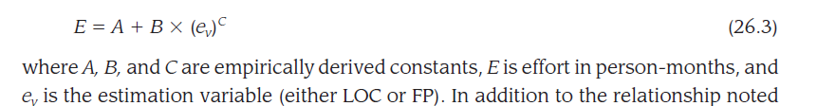
Empirical Estimation Models
Estimation models for computer software use empirically derived formulas to predict effort as a function of LOC (line of code) or FP(function point)
Resultant values computed for LOC or FP are entered into an estimation model
The empirical data for these models are derived from a
limited sample of projects
– Consequently, the models should be calibrated to reflect local software development conditions
32

Slide 55
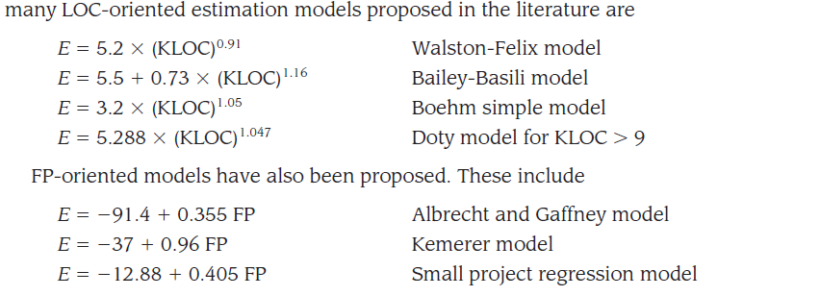

Slide 56
COCOMO
Stands for Constructive Cost Model
Introduced by Barry Boehm in 1981 in his book “Software Engineering Economics”
Became one of the well-known and widely-used estimation models in the industry
It has evolved into a more comprehensive estimation model called COCOMO II
COCOMO II is actually a hierarchy of three estimation models
As with all estimation models, it requires sizing information and accepts it in three forms: object points, function points, and lines of source code
(More on next slide)
33

Slide 57
COCOMO –II
uses object points
object point is an indirect software measure that is computed using counts of the number of (1) screens (at the user interface), (2) reports, and (3) components likely to be required to build the application.
Each object instance (e.g., a screen or report) is classified into one of three complexity levels (i.e., simple, medium, or difficult) using criteria suggested by Boehm
Once complexity is determined, the number of screens, reports, and components are weighted according to the table illustrated
The object point count is then determined by multiplying the original number of object instances by the weighting factor and summing to obtain a total object point count

Slide 58
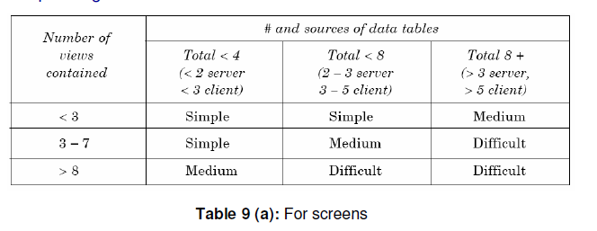
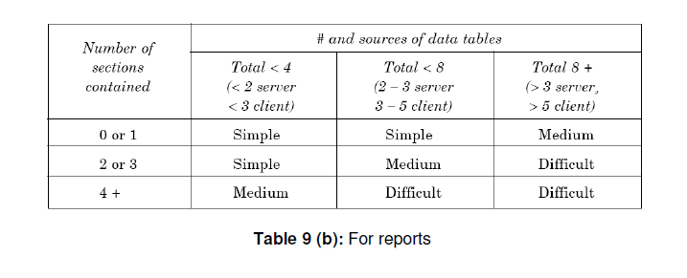

Slide 59
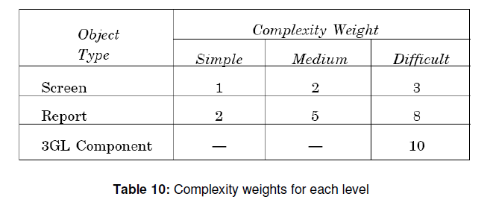

Slide 60
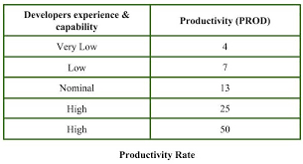
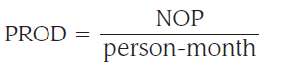
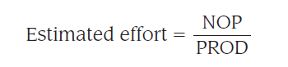
COCOMO -II
When the software is reused ...then percentage of reuse is estimated and the object point count is adjusted by using the formula
NOP = (object points) X [(100 - %reuse)/100]
where NOP is defined as new object points.
To derive an estimate of effort based on the computed NOP value, a “productivity rate” must be derived.
Once the productivity rate has been determined, an estimate of project effort.

Slide 61
Ans
Step-1: Number of screens = 4 Number of records = 2
Step-2: For screens, Number of views = 4 Number of data tables = 7 Number of servers = 3 Number of clients = 4
by using above given information and table (For Screens), Complexity level for each screen = medium
For reports, Number of sections = 6 Number of data tables = 7 Number of servers = 2 Number of clients = 3 by using above given information and table (For Reports), Complexity level for each report = difficult
Step-3: By using complexity weight table we can assign complexity weight to each object instance depending upon their complexity level. Complexity weight for each screen = 2 Complexity weight for each report = 8

Slide 62
Step-4:
Object point count = sigma (Number of object instances) * (its Complexity weight) = 4 * 2 + 2 * 8 = 24
Step-5:
%reuse of object points = 10% (given)
NOP = [object points * (100 - %reuse)]/100
= [24 * (100 -10)]/100 = 21.6
Step-6: Developer’s experience and capability is low (given) Using information given about developer and productivity rate table Productivity rate (PROD) of given project = 7
Step-7:
Effort = NOP/PROD = 21.6/7 = 3.086 person-month
Therefore, effort to develop the given project = 3.086 person-month.

Slide 63
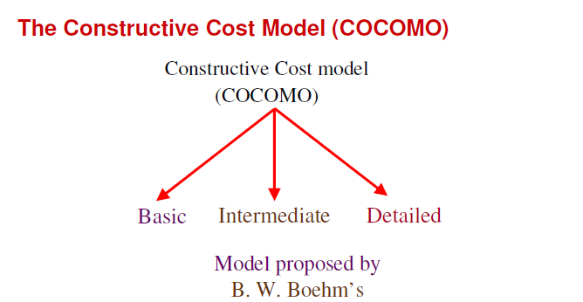
COCOMO Models
34

Slide 64
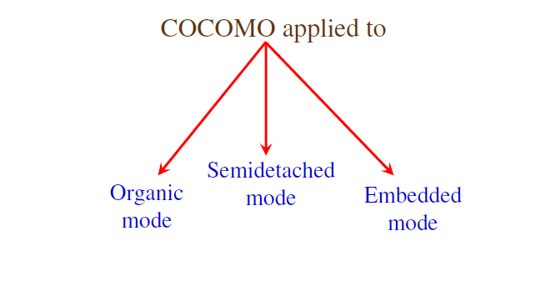

Slide 65
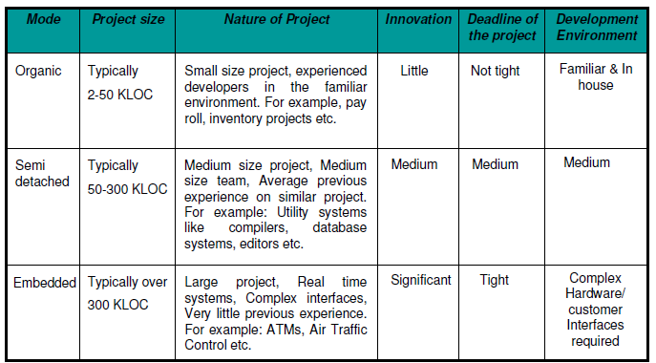
Comparison of 3 COCOMO models

Slide 66
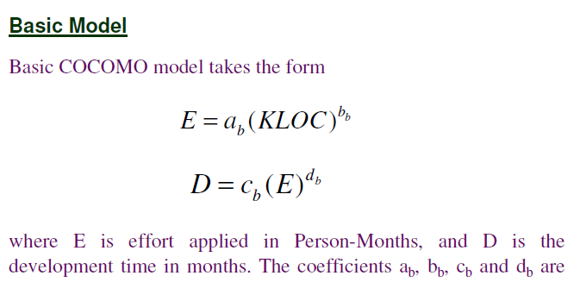
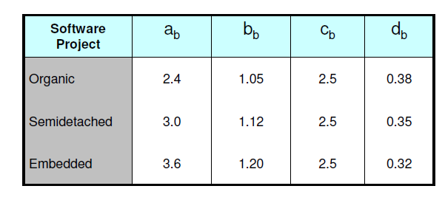

Slide 67
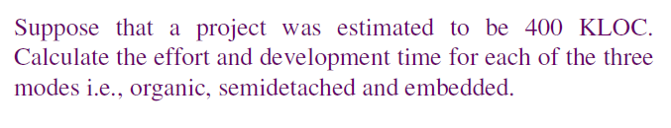
Example

Slide 68
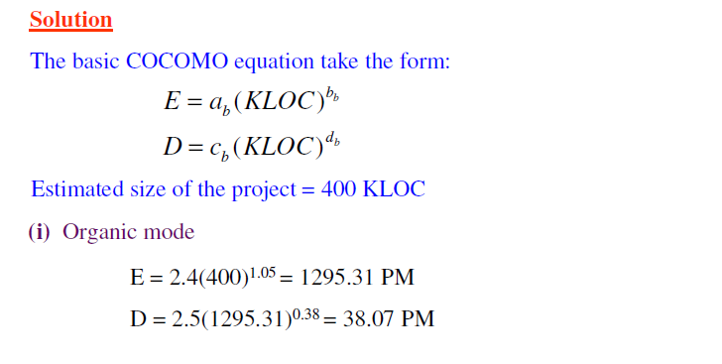


Slide 69
Example 2 (HW)
A project size of 200 KLOC is to be developed. Software development team has average experience on similar type of projects. The project schedule is not very tight. Calculate the effort, development time.

Slide 70

Solution

Slide 71


Slide 72
The Software Equation
The software equation [Put92] is a dynamic multivariable model that assumes a specific distribution of effort over the life of a software development project.
Derived from productivity data collected for over 4,000 contemporary software projects

Slide 73


The Software Equation

Slide 74
Productivity parameter
Reflects:
overall process maturity and management practices,
the extent to which good software engineering practices are used,
the level of programming languages used,
the state of the software environment,
the skills and experience of the software team,
and the complexity of the application

Slide 75
Typical value of P
P = 2,000 for development of real-time embedded software,
P = 10,000 for telecommunication and systems software,
P=12000 for scientific software (CAD)
P=28,000 for business systems applications
The productivity parameter can be derived for local conditions using historical data collected from past development efforts.

Slide 76
Software equation…
The software equation has two independent parameters:
(1) an estimate of size (in LOC) and
(2) an indication of project duration in calendar months or years.
To simplify the estimation process, Putnam and Myers [Put92] suggest a set of equations derived from the software equation.

Slide 77

Minimum development time is defined as
Where t is represented in years

Slide 78

Example
Consider the CAD software
Recommended value of P=12000 ( for scientific software)

Slide 79


Example (HW)

Slide 80




















Slide 81
FOR OBJECT-ORIENTED PROJECTS
Lorenz and Kidd [Lor94] suggest the following approach:
Develop estimates using effort decomposition, FP analysis, and any other method that is applicable for conventional applications.
Using the requirements model, develop use cases and determine a count. Recognize that the number of use cases may change as the project progresses.

Slide 82

Estimation of OO projects…
From the requirements model, determine the number of key classes.(Analysis classes).
4. Categorize the type of interface for the application and develop a multiplier for support classes

Slide 83
Estimation of OO projects
5. Multiply the number of key classes (step 3) by the multiplier to obtain an estimate for the number of support classes.
6. Multiply the total number of classes (key + support) by the average number of work-units per class.
Lorenz and Kidd suggest 15 to 20 person-days per class
Cross check the class-based estimate by multiplying the average number of work-units per use-case!

Slide 84
Thank you

Slide 85

Agile models

Slide 86
Scrum
Scrum as a better way of building products.
Scrum is a lightweight framework, simple to understand but difficult to master.
Scrum is used everywhere. (90% of agile team use scrum, it has only one scrum guide)
Scrum incorporates a set of process patterns that emphasize project priorities, compartmentalized work units, communication, and frequent customer feedback.

Slide 87

Scrum

Slide 88
Scrum
Meetings are very short (15 minutes daily) and sometimes conducted without chairs ( what did you do since last meeting? What obstacles are you encountering? What do you plan to accomplish by next meeting?) – scrum board
“demos” are delivered to the customer with the time-box allocated. May not contain all functionalities. So customers can evaluate and give feedbacks.
3 artifacts – product backlog, sprint backlog and increment ( shippable product)
3 roles – Scrum team, scrum master, product owner
Developer team is self organizing – cross functional team members

Slide 89

Scrum

Slide 90

Scrum Process

Slide 91


Scrum Board

Slide 92
LEAN
Lean software development is a concept that emphasizes optimizing efficiency and minimizing waste in the software development process. This approach has its roots in the Lean manufacturing movement of the 1980s. However, it is now considered an integral part of the Agile software development methodology.

Slide 93
Kanban
Kanban is a popular framework used to implement agile and DevOps software development. It requires real-time communication of capacity and full transparency of work. Work items are represented visually on a kanban board, allowing team members to see the state of every piece of work at any time.

Slide 94
SCRUM | EXTREME PROGRAMMING (XP)
In Scrum framework, team work in iterations called Sprint which are 1-2 month long. | In Extreme Programming(XP), teamwork for 1-2 weeks only. Pair programming (2 members per team)
Scrum is the type of Agile framework. It is a framework within which people can address complex adaptive problem while productivity and creativity of delivering product is at highest possible values. | Extreme Programming is one of the most important models of Agile framework. This model emphasizes team-work and customer satisfaction as well.
Scrum model do not allow changes in their timeline or their guidelines. | Extreme Programming allow changes in their set timelines.
Scrum emphasizes self-organization. | Extreme Programming emphasizes strong engineering practices (pairprogramming,refactoring...)
In Scrum framework, team determines the sequence in which the product will be developed. | In Extreme Programming, team have to follow a strict priority order or pre-determined priority order.
Scrum framework is not fully described. If you want to adopt it then you need to fill the framework with your own frameworks method like XP, DSDM or Kanban. | Extreme Programming(XP) can be directly applied to a team. Extreme Programming is also known for its Ready-to-apply features.
https://www.visual-paradigm.com/scrum/extreme-programming-vs-scrum/

Slide 95


Slide 96


Slide 97

L30 – means light criticality with 30 members
Ex: L200 – hospital management s/w or NASA

Slide 98


Slide 99



Slide 100



Slide 101



Slide 102


Slide 103


Slide 104


Slide 105


Slide 106


Slide 107


Slide 108

SCRUM BOARD

Slide 109


Slide 110


